Slide 1

Capstone Project - 4
Topic Modeling on News Articles
Team members
Ajinkya Morade
Nitesh Gajakosh

Slide 2
Content
Problem definition
Introduction
Topic modeling
EDA on given data
Model implementation
Model validation and selection
Conclusion
References

Slide 3
Problem definition
In this project your task is to identify major themes/topics across a collection of BBC news article. With using clustering algorithms such as Latent Dirichlet Allocation (LDA).

Slide 4
Introduction
In the Web era, people tend to rely on the Web to receive News instead of traditional ways such as newspapers.
In the past decades, text classification has been a hot topic and received attention from many scholars.
In areas such as natural language processing, information Retrieval, and machine learning, etc.
A major source for such similarity measurement is the content of the news articles, which is mostly textual.

Slide 5
Introduction
Therefore, techniques of text classification or text mining were commonly adopted to tackle the news classification tasks.
Aim of the project is to put a model on given data for classification of news types.
Data taken for this project is BBC news data.

Slide 6
Topic modeling on Data
Topic modeling is a type of statistical modeling for discovering the abstract “topics” that occurs in a collection of documents.
Latent Dirichlet Allocation (LDA) is an example of topic model and is used to classify the text in a document into a particular topic.

Slide 7
EDA
Digging into data we understand that
There is no null value in the data set.
News: Text document of news article of various types.
Type: Type of news article such as Business, Politics, Tech, Entertainment and Sports.

Slide 8
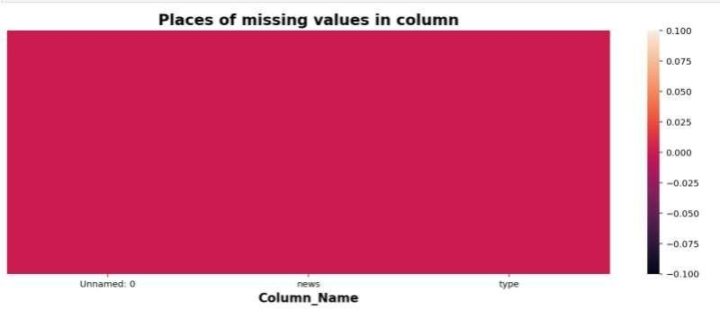
EDA
We can see there is no null values in the given data set.
Fig 1: Missing values in data set.

Slide 9
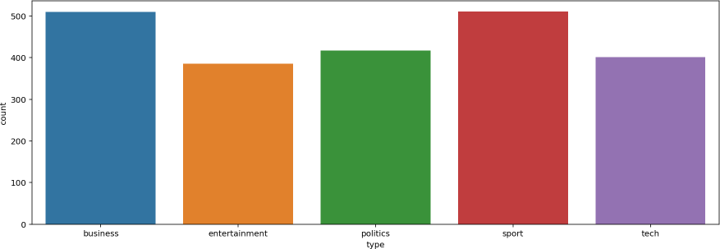
EDA
Count of news type in data
Fig 2: News type count plot.

Slide 10
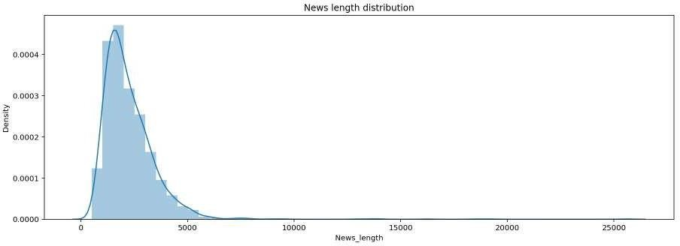
EDA
Max news length is of 2500 words.
Fig 3: News length distribution.

Slide 11
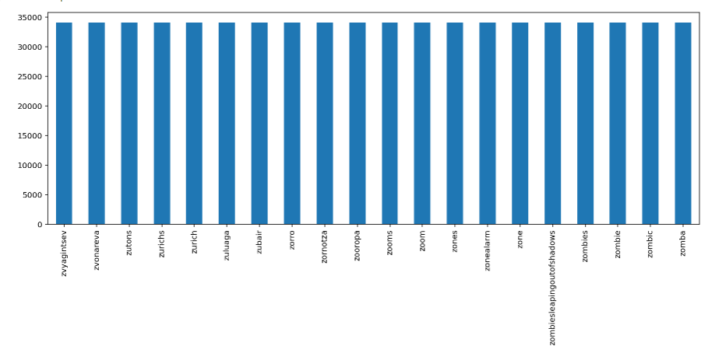
EDA
Overall news length in total text.
Fig 4: News words (Overall).

Slide 12
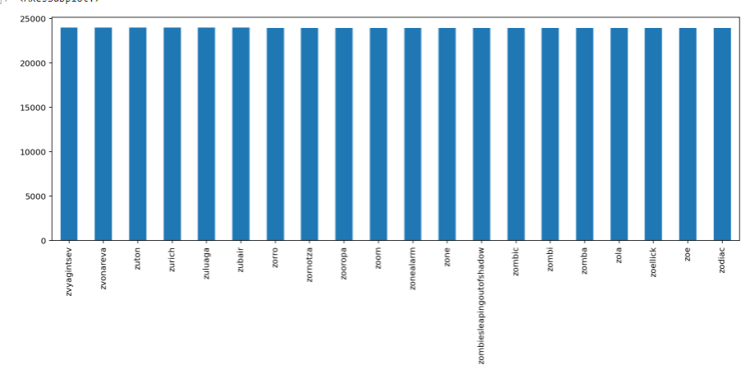
EDA
Overall news words after applying stemming.
Fig 5: News words after applying stemming.

Slide 13
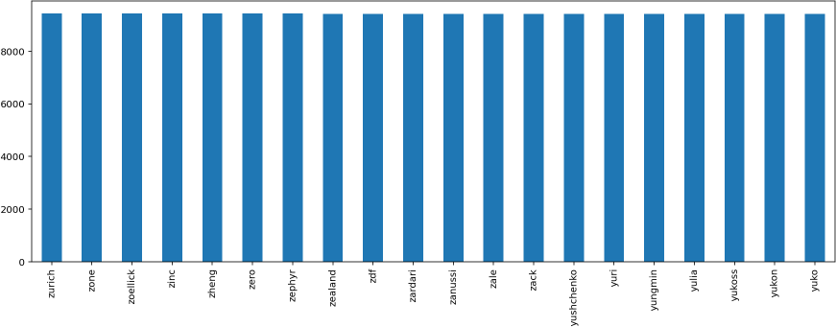
EDA
Count of words in Business data after applying stemming.
Fig 6:Business data words.

Slide 14
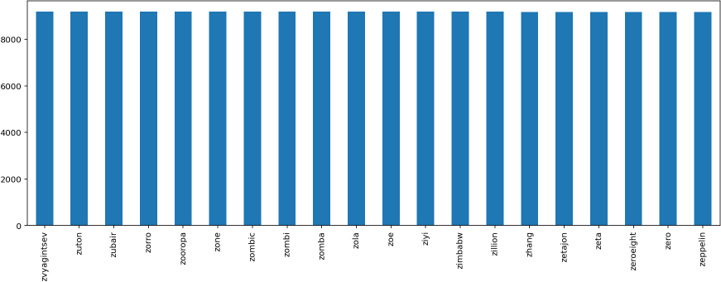
EDA
Count of words in Entertainment data after applying stemming.
Fig 7: Entertainment data words.

Slide 15
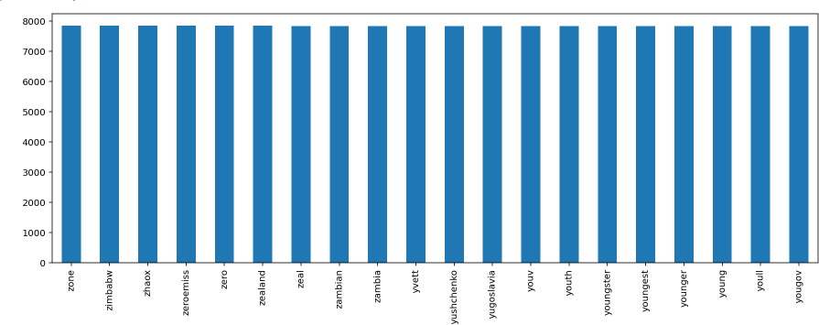
EDA
Count of words in Politics data after applying stemming.
Fig 8: Politics data words.

Slide 16
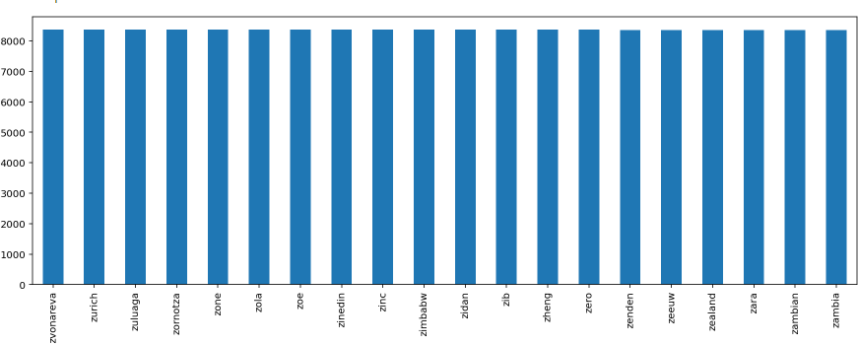
EDA
Count of words in Sports data after applying stemming.
Fig 9: Sports data words.

Slide 17
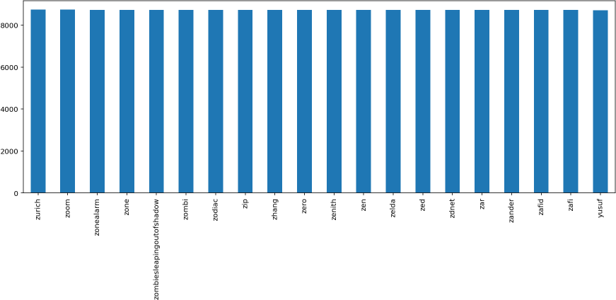
EDA
Count of words in Tech data after applying stemming.
Fig 10: Tech data words.

Slide 18

EDA
Maximum frequency words in Business data.
Fig 11: Words in Business data.

Slide 19

EDA
Maximum frequency words in Entertainment data.
Fig 12: Words in Entertainment data.

Slide 20

EDA
Maximum frequency words in Politics data.
Fig 13: Words in Politics data.

Slide 21
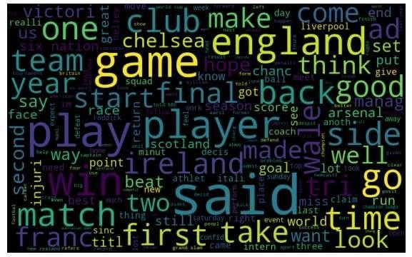
EDA
Maximum frequency words in Sport data.
Fig 14: Words in Sport data.

Slide 22

EDA
Maximum frequency words in Tech data.
Fig 15: Words in Tech data.

Slide 23
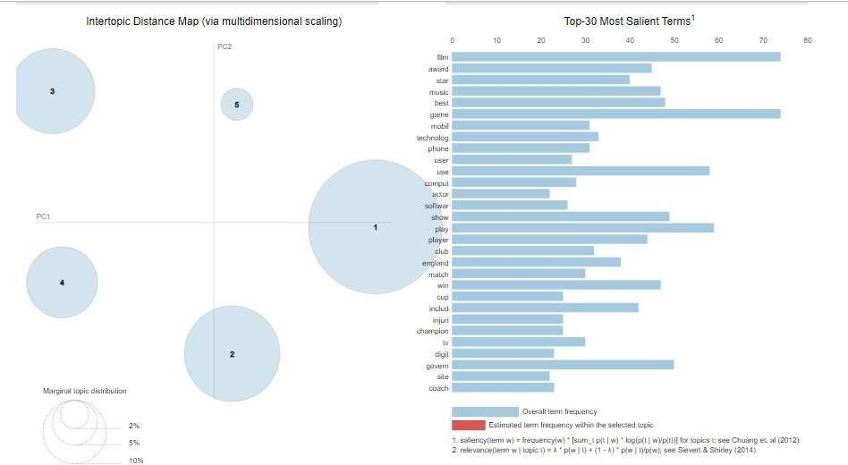
EDA
Lda clusters

Slide 24
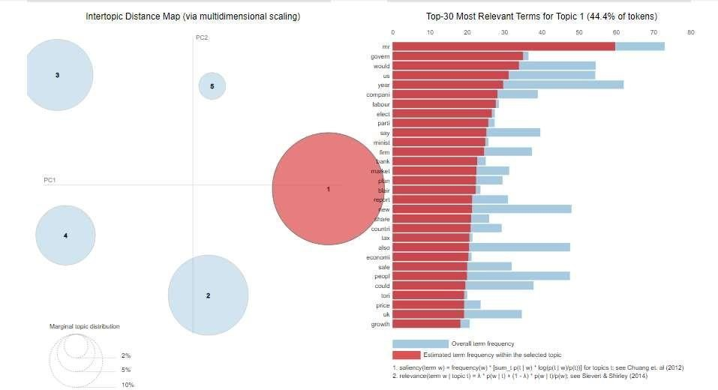
EDA
Lda cluster 1 - Politics

Slide 25
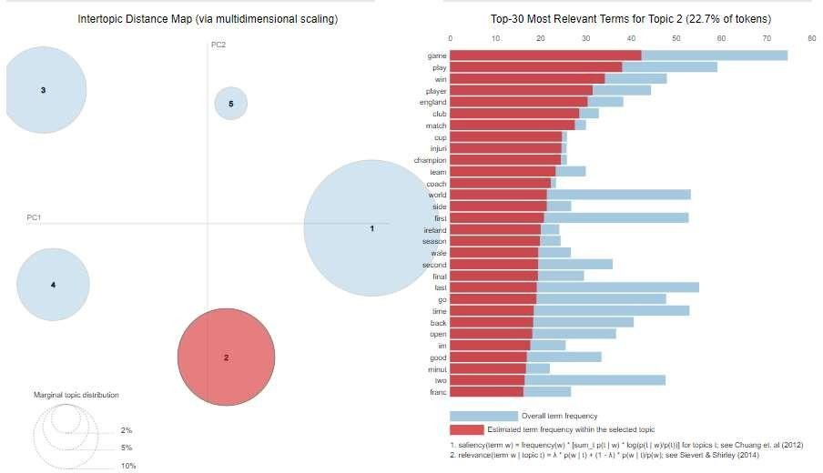
EDA
Lda cluster 2 - Sports

Slide 26
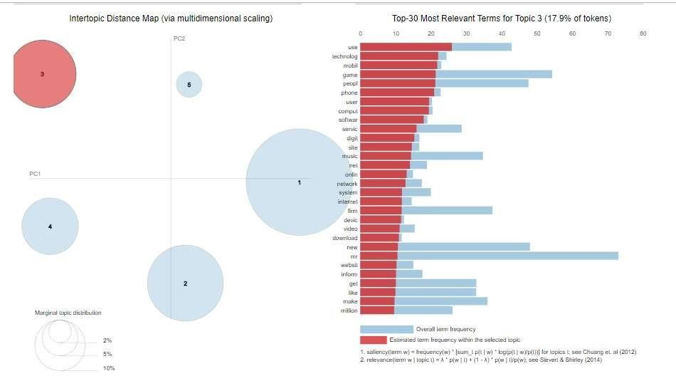
EDA
Lda cluster 3 - Tech

Slide 27
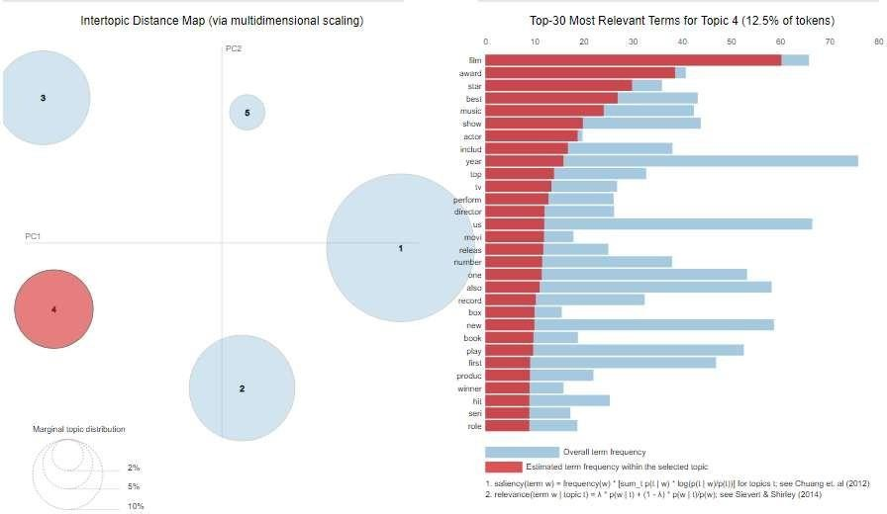
EDA
Lda cluster 4 – Entertainment

Slide 28
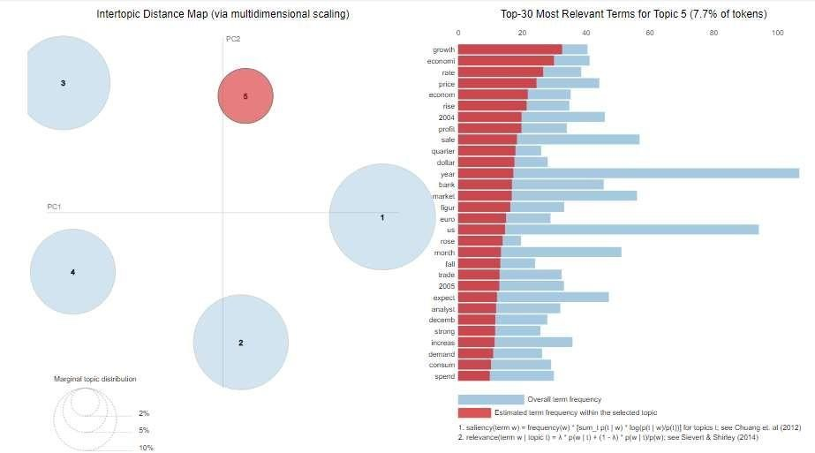
EDA
Lda cluster 5 – Business

Slide 29
Model implementation
After implementing various models on the given data such as Logistic Regression, Decision Tree Classifier, Naïve Bays Classifier, KNN Classifier, Random Forest Classifier. Train and test accuracy are as follows.
Model | Train | Test
Logistic Regression | 0.98 | 0.95
Decision Tree Classifier | 1.00 | 0.86
Random Forest Classifier | 1.00 | 0.91
Naïve Bays Classifier | 0.95 | 0.92
KNN Classifier | 0.96 | 0.95
Table 1 Result table of models.

Slide 30
Model implementation
We get maximum accuracy with KNN classifier and Logistic regression with train and test accuracy as
KNN Classifier Train accuracy: 0.96, Test accuracy: 0.95
Logistic Regression Train accuracy: 0.98, Test accuracy: 0.95
As per the working of KNN classifier we would like implement it on News classification.
Model | Train | Test
KNN Classifier | 0.96 | 0.95
Logistic Regression | 0.98 | 0.95
Table 2 Result table of Complex models.

Slide 31
Conclusion
The news is platform used in almost every second in different sources of media in soft and hard.
Due to impact of social media everyone is referring to online news platform therefore, News classification became important aspect.
We get maximum accuracy with KNN classifier and Logistic regression with train and test accuracy as 0.96,0.95 and 0.98, 0.95respectively.
As per the working of KNN classifier we would like implement it on News classification.

Slide 32
References
[1] “Content Enrichment Using Linked Open Data for news Classification” by Hsin-Chang Yang, Yu-Chih Wang.
” Classification of News Articles using Supervised Machine Learning Approach” by Muhammad Imran Asad, Muhammad Abubakar siddique, Safdar Hussain, Hafiz Naveed Hassan, and Jam Munawwar Gul.
” Text classification of BBC news articles and text summarization using text rank” by Abhishek Dutt and Kirk Smalley.

Slide 33
Thank You…

